Slide 1



DC Properties
View in Power BI
Last data refresh:
8/11/2022 8:03:54 PM UTC
Downloaded at:
8/12/2022 2:33:27 AM UTC

Slide 2
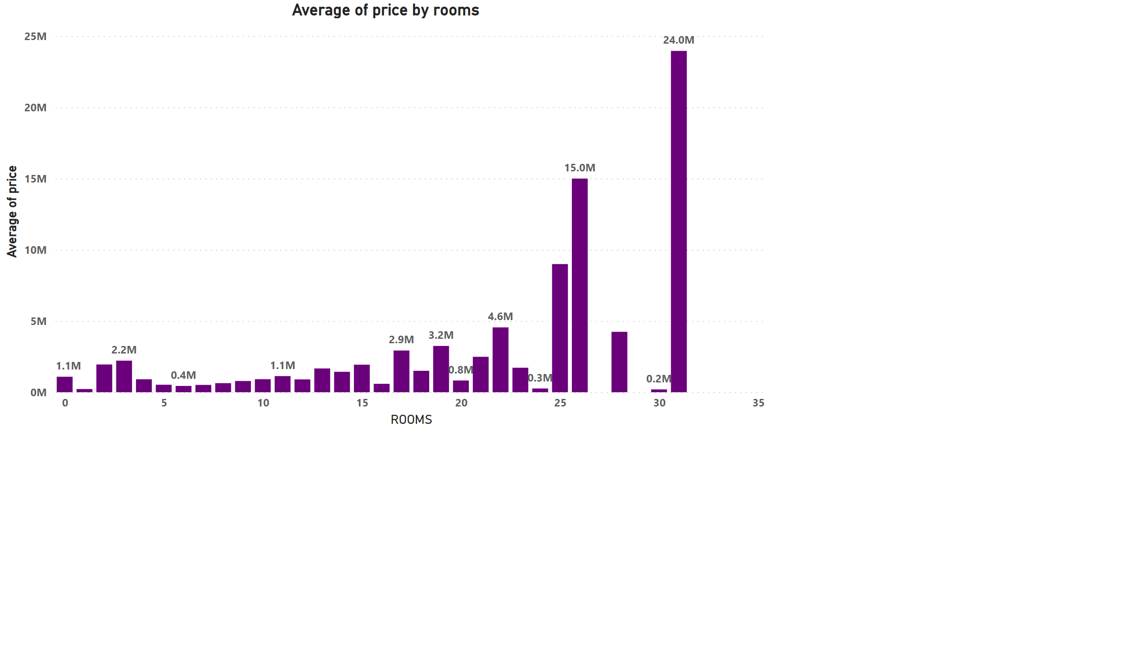
Page 1
Notes:
Average of price by rooms
No alt text provided

Slide 3
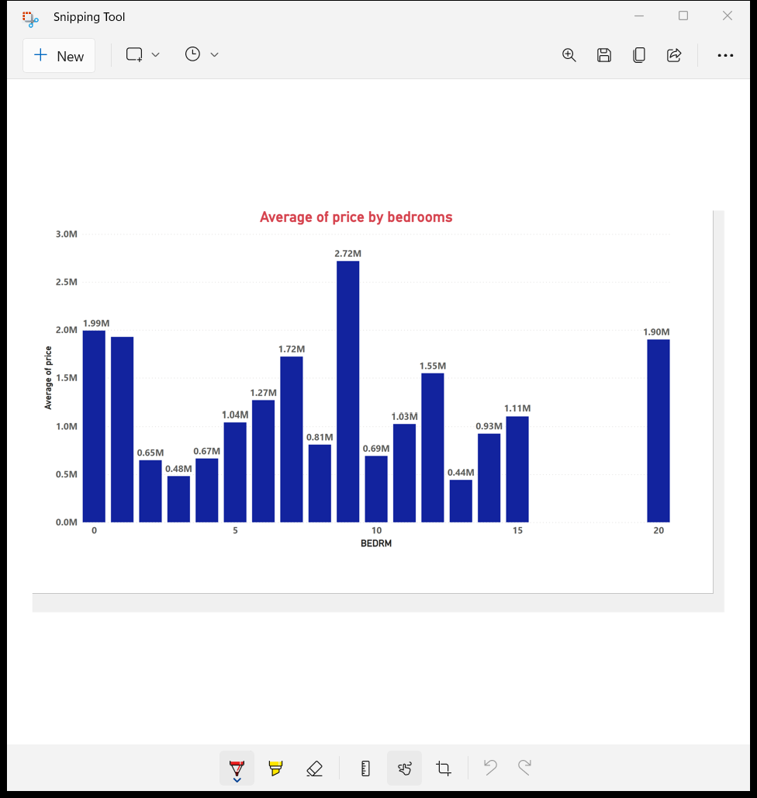

Slide 4
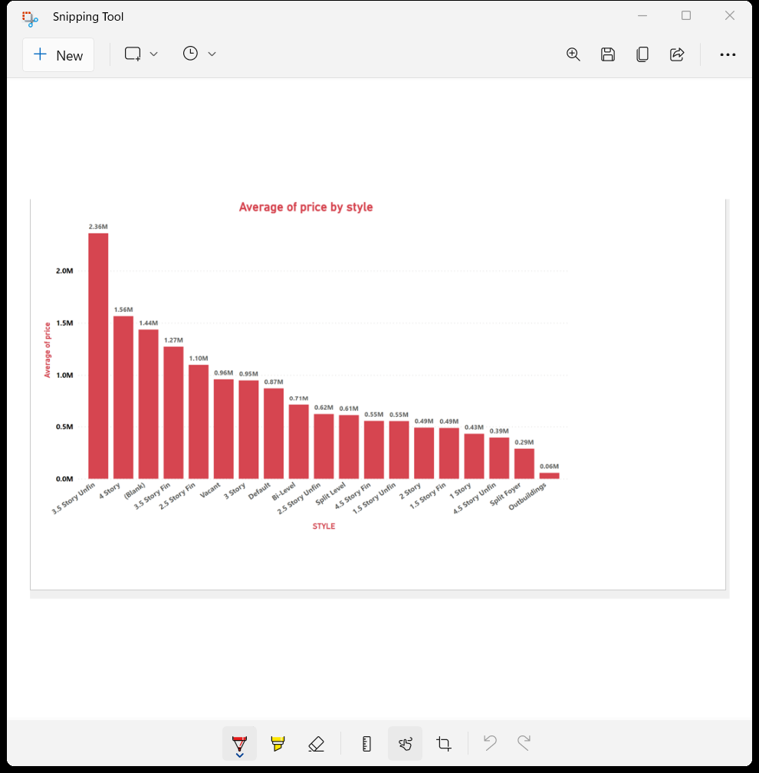

Slide 5
